Slide 1
Lecture 5
Topics
  Canonical or Standard Forms of Functions
    SOP (Sum of Products) form
    POS (Product of Sums) form
    Relationship Between MinTerms and MaxTerms
    Converting Between Compact Forms of Functions
  Minimizing (Reducing) Functions
    Karnaugh Maps (K-maps)
    Product term sharing

Slide 2
Boolean Equations

Slide 3
Obtaining a Boolean Equation
In Ecotopia it’s generally illegal to use a car pool lane during weekdays if the car doesn’t have at least two occupants. However, hybrid vehicles can use the lanes any time regardless of the number of occupants. SUVs (even with two or more occupants) are never allowed to use the car pool lanes (unless they are also hybrids).
Write a Boolean expression in SOP form for F(W, O, S, H) which is 1 if the car is permitted to use the car pool lane today. W is 1 if today is a weekday. O is 1 if there are two or more occupants, S is 1 if the vehicle is an SUV, H is 1 if the vehicle is a hybrid.
W O S H F
----------
0 0 0 0 1
0 0 0 1 1
0 0 1 0 0
0 0 1 1 1
0 1 0 0 1
0 1 0 1 1
0 1 1 0 0
0 1 1 1 1
1 0 0 0 0
1 0 0 1 1
1 0 1 0 0
1 0 1 1 1
1 1 0 0 1
1 1 0 1 1
1 1 1 0 0
1 1 1 1 1
ECOTOPIA EXAMPLE

Slide 4
Deriving Boolean Equations
A truth table is a complete, unambiguous definition of a Boolean function…
But how do we get a Boolean expression from a truth table?
  SOP or POS
X Y Z F
0 0 0 0
0 0 1 0
0 1 0 0
0 1 1 1
1 0 0 1
1 0 1 0
1 1 0 1
1 1 1 0
F = X⋅Y⋅Z + X⋅Y⋅Z + X⋅Y⋅Z

Slide 5
Obtaining SOP Forms of Functions
F(A,B) = F(0,0)⋅A⋅B + F(0,1)⋅A⋅B + F(1,0)⋅A⋅B + F(1,1)⋅A⋅B
= 0⋅A⋅B + 1⋅A⋅B + 1⋅A⋅B + 1⋅A⋅B
= 0 + A⋅B + A⋅B + A⋅B
= A⋅B + A⋅B + A⋅B
A B F(A,B)
0 0 0 = F(0,0)
0 1 1 = F(0,1)
1 0 1 = F(1,0)
1 1 1 = F(1,1)
Canonical or Standard
SOP Form
Standard Product Term
(Minterm)
Reduced Form
A + B
OR truth table
Notes:
Comes from Claude Shannon’s MS work. Simplified way of looking at it: just list the “terms” of AB (and complements) which result in function value of 1.

Slide 6
Minterms and Maxterms
Notes:
Majority Function

Slide 7
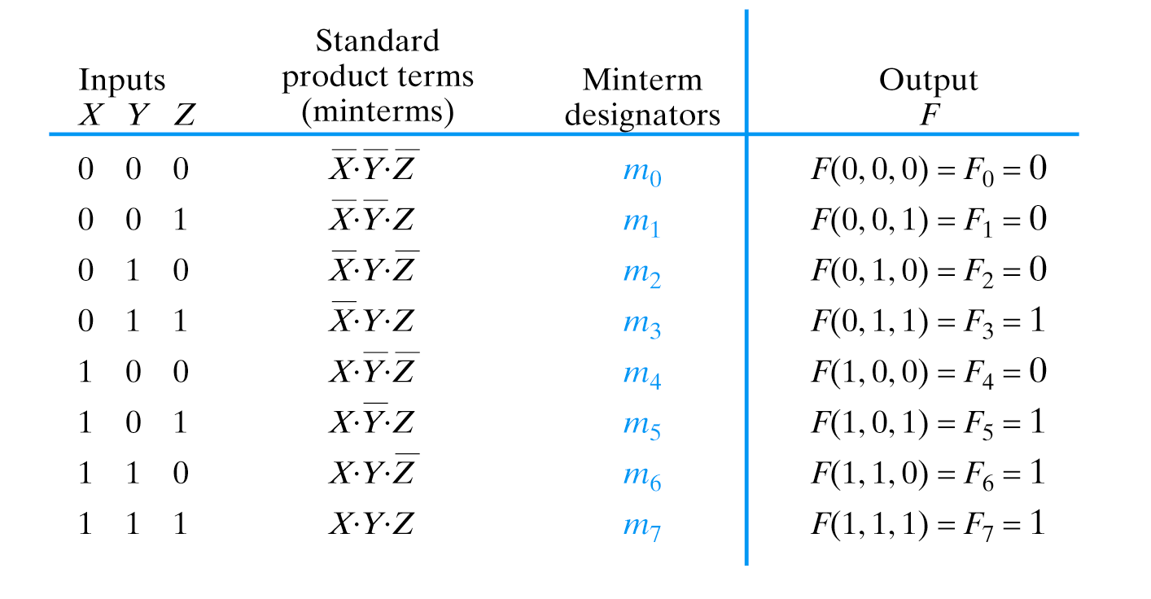
Minterms
Notes:
Majority Function

Slide 8
Compact Minterm Form
F(A,B) = F(0,0)⋅A⋅B + F(0,1)⋅A⋅B + F(1,0)⋅A⋅B + F(1,1)⋅A⋅B
= Σ³_{i=0} (F_{i} ⋅ m_{i})
= 0 ⋅ m₀ + 1 ⋅ m₁ + 1 ⋅ m₂ + 1 ⋅ m₃
= m₁ + m₂ + m₃
= Σ m(1,2,3)
= Σ (1,2,3)
A B F(A,B)
0 0 0 = F(0,0)
0 1 1 = F(0,1)
1 0 1 = F(1,0)
1 1 1 = F(1,1)
OR truth table
Notes:
Comes from Claude Shannon’s MS work. Simplified way of looking at it: just list the “terms” of AB (and complements) which result in function value of 1.

Slide 9
Minterms
Σ (3,5,6,7)

Slide 10
Generalized Compact Minterm Form
F(X₁, X₂,… X_{n}) = Σ (minterms for 1s of the function)
F(X₁, X₂,… X_{n}) = Σ (minterms for 0s of the function)

Slide 11
Obtaining POS Forms of Functions
F(A,B) = (F(0,0) + A + B) ⋅ (F(0,1) + A + B)
⋅ (F(1,0) + A + B) ⋅ (F(1,1) + A + B)
= (0 + A + B) ⋅ (0 + A + B) ⋅ (0 + A + B) ⋅ (1 + A +B)
= (A+B) ⋅ (A+B) ⋅ (A+B) ⋅ (1)
= (A+B) ⋅ (A+B) ⋅ (A+B)
AND truth table
A B F(A,B)
0 0 0 = F(0,0)
0 1 0 = F(0,1)
1 0 0 = F(1,0)
1 1 1 = F(1,1)
Canonical or Standard
POS Form
Standard Sum Term
(Maxterm)
Reduced Form
A ⋅ B
Notes:
Comes from Claude Shannon’s MS work. Simplified way of looking at it: just list the “terms” of AB (and complements) which result in function value of 1.

Slide 12
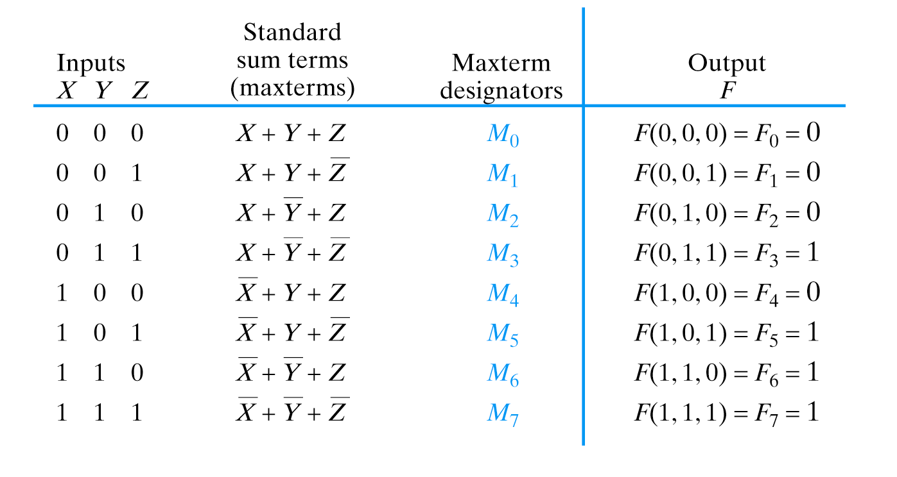
Maxterms
Notes:
Majority Function

Slide 13
Compact Maxterm Form
F(A,B) = (F(0,0) + A + B) ⋅ (F(0,1) + A + B)
⋅ (F(1,0) + A + B) ⋅ (F(1,1) + A + B)
= Π³_{i=0} (F_{i} + M_{i})
= (0 + M₀) ⋅ (0 + M₁) ⋅ (0 + M₂) ⋅ (1 + M₃)
= M₀ ⋅ M₁ ⋅ M₂
= Π M(0,1,2)
= Π (0,1,2)
AND truth table
A B F(A,B)
0 0 0 = F(0,0)
0 1 0 = F(0,1)
1 0 0 = F(1,0)
1 1 1 = F(1,1)
Notes:
Comes from Claude Shannon’s MS work. Simplified way of looking at it: just list the “terms” of AB (and complements) which result in function value of 1.

Slide 14
Maxterms
Π (0,1,2,4)
Notes:
Majority Function

Slide 15
Generalized Compact Maxterm Form
F(X₁, X₂,… X_{n}) = Π (maxterms for 0s of the function)
F(X₁, X₂,… X_{n}) = Π (maxterms for 1s of the function)

Slide 16
Relationship Between Minterms and Maxterms
m_{i} = M_{i}, M_{i} = m_{i}
Σ = Π, Π = Σ

Slide 17
An example: Given the accompanying truth table, write the compact minterm form for F for its 1s and 0s. Write the standard SOP form for each.
Compact minterm form 1s:
F = Σ(3,4,6)
X Y Z F
0 0 0 0
0 0 1 0
0 1 0 0
0 1 1 1
1 0 0 1
1 0 1 0
1 1 0 1
1 1 1 0
Corresponding SOP form:
F = X⋅Y⋅Z + X⋅Y⋅Z + X⋅Y⋅Z
Compact minterm form 0s:
F = Σ(0,1,2,5,7)
Corresponding SOP form:
F = X⋅Y⋅Z + X⋅Y⋅Z + X⋅Y⋅Z + X⋅Y⋅Z + X⋅Y⋅Z
This is example problem 15, page 85. Solution on page 107.

Slide 18
An example: Given the accompanying truth table, write the compact maxterm form for F for its 1s and 0s. Write the standard POS form for each.
This uses the same truthtable as the preceding problem but asks for maxterms
Compact maxterm form 1s:
X Y Z F
0 0 0 0
0 0 1 0
0 1 0 0
0 1 1 1
1 0 0 1
1 0 1 0
1 1 0 1
1 1 1 0
F = Π(3,4,6)
Corresponding POS form:
F = (X+Y+Z) ⋅ (X+Y+Z) ⋅ (X+Y+Z)
Compact maxterm form 0s:
F = Π(0,1,2,5,7)
Corresponding POS form:
F = (X+Y+Z) ⋅ (X+Y+Z) ⋅ (X+Y+Z)
⋅ (X+Y+Z) ⋅ (X+Y+Z)

Slide 19
Function Minimization: Reduce Number of Literals and Terms
Simplify for Comprehension
Reduce Number of Components
Reduce Amount of Wiring/Routing
Smaller Circuit/Board Area
Lower Cost
Higher Reliability
Notes:
Now we can derive an equation for a Boolean function from a truth table. How about minimizing it?

Slide 20
Function Minimization: Reduce Number of Literals and Terms
Apply Boolean Algebra
Employ Computer Algorithm
  Quine-McCluskey tabular algorithm
  Boozer
  McBoole
  Espresso and Espresso/Exact (CAD packages)
Systematic Algebraic Reduction (SAR)
Karnaugh Maps (K-Maps)

Slide 21
Karnaugh Maps

Slide 22
Karnaugh (K) Maps
A graphical representation of Boolean function
Easy to perform functional reduction
Relies on adjacency (Gray code) of minterms
  Adjacent (horizontal/vertical & wrap around) cells
  differ in only one variable (complement)
Number form and Variable form

Slide 23
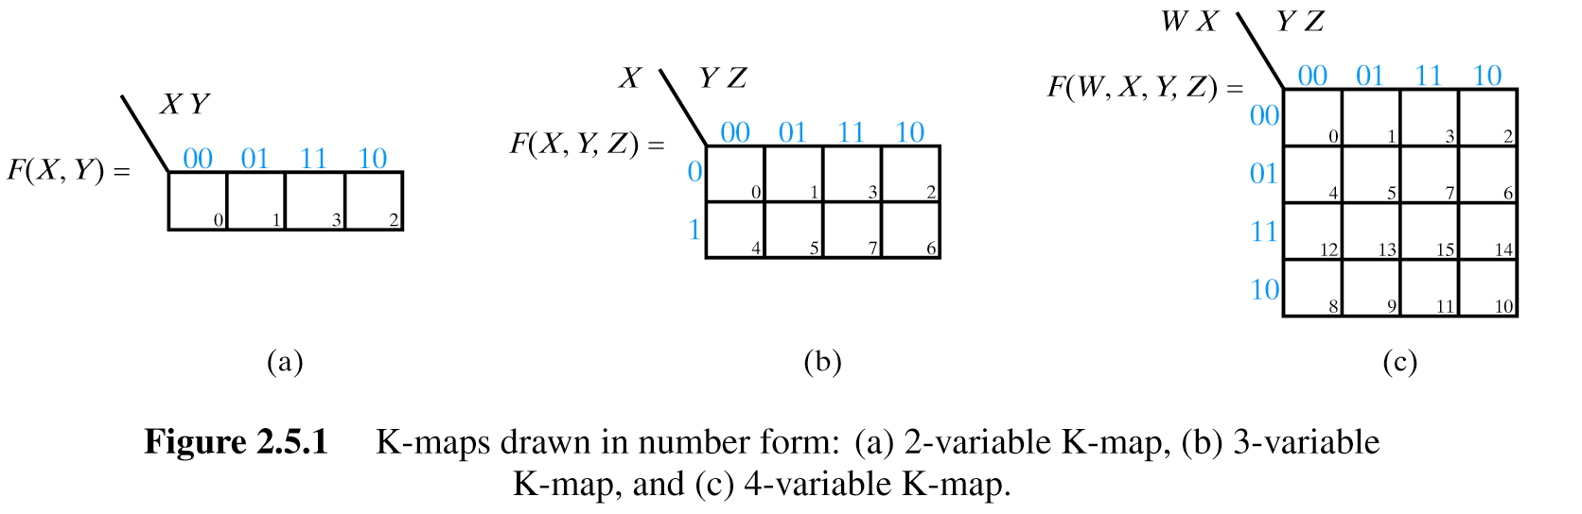
K-Maps
2 Variable K-Map (Number Form)
Gray code!
Minterm numbers

Slide 24
K-Maps
3 Variable K-Map (Number Form)
Gray code!
Minterm numbers

Slide 25
K-Maps
4 Variable K-Map (Number Form)
Gray code!
Minterm numbers

Slide 26
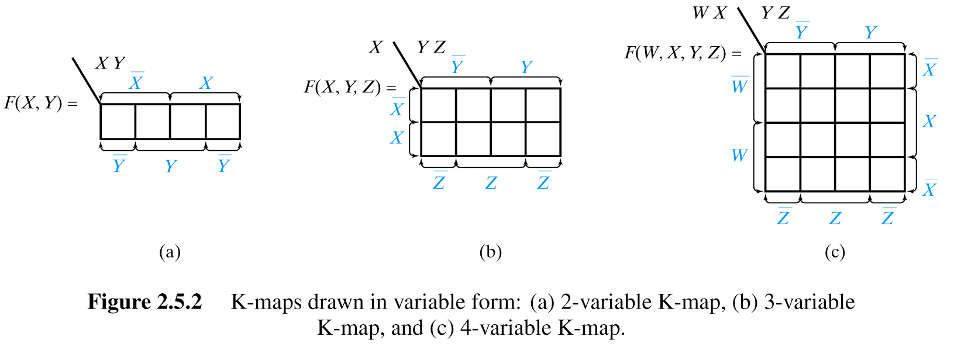
K-Maps
2 Variable K-Map (Variable Form)
May be more useful if plotting partially reduced functions
Careful! Preserve Gray code!

Slide 27
K-Maps
3 Variable K-Map (Variable Form)

Slide 28
K-Maps
4 Variable K-Map (Variable Form)

Slide 29
My Preference…
Y
Y
W
X
W
Z

Slide 30
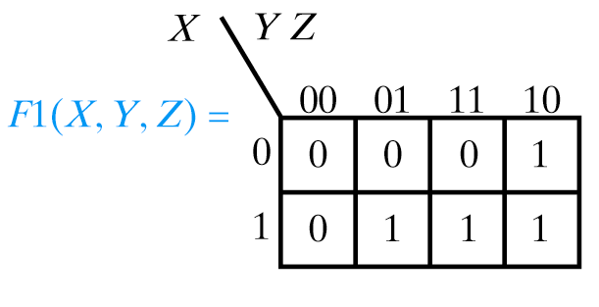
Plotting Functions in K-Maps
Plot the function F1(X,Y,Z) = Σ(2,5,6,7)
X Y Z F1
0 0 0 0
0 0 1 0
0 1 0 1
0 1 1 0
1 0 0 0
1 0 1 1
1 1 0 1
1 1 1 1
Notes:
May be given function in truth table, compact minterm/maxterm, or partially reduced (equation) form…
We’ll look at 1st two first

Slide 31
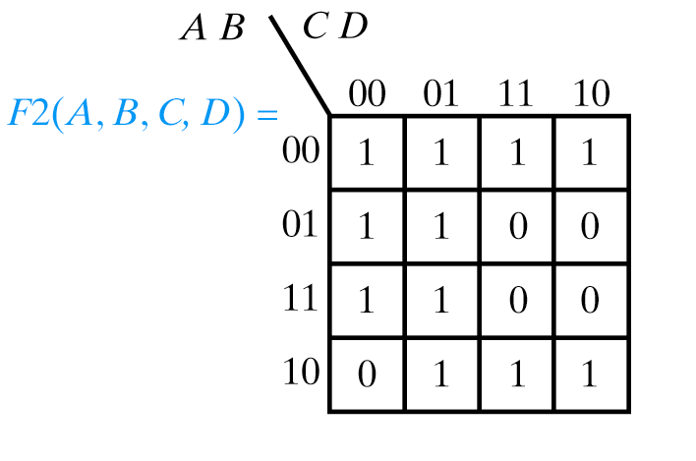
Plotting Functions in K-Maps
Plot the function F2(A,B,C,D) = Σ(6,7,8,14,15)
Plot 0s!

Slide 32
Don’t Care Outputs

Slide 33
Don’t Care Outputs
BCD
A B C D Prime
0 0 0 0 0
0 0 0 1 1
0 0 1 0 1
0 0 1 1 1
0 1 0 0 0
0 1 0 1 1
0 1 1 0 0
0 1 1 1 1
1 0 0 0 0
1 0 0 1 0
1 0 1 0 X
1 0 1 1 X
1 1 0 0 X
1 1 0 1 X
1 1 1 0 X
1 1 1 1 X
0
1
2
3
4
5
6
7
8
9
.
.
.
.
.
.
Output of Function Doesn’t Matter
  Typically impossible input condition
  Use X instead of 0 or 1

Slide 34
Don’t Care Outputs
Compact Minterm and Maxterm Form
F3(A,B,C) = Σ(2,6) + Σmd(3,5,7)
F3(A,B,C) = Σ(0,1,4) + Σmd(3,5,7)
F3(A,B,C) = Π(0,1,4) ⋅ ΠMd(3,5,7)
F3(A,B,C) = Π(2,6) ⋅ ΠMd(3,5,7)
A B C F3
0 0 0 0
0 0 1 0
0 1 0 1
0 1 1 X
1 0 0 0
1 0 1 X
1 1 0 1
1 1 1 X

Slide 35
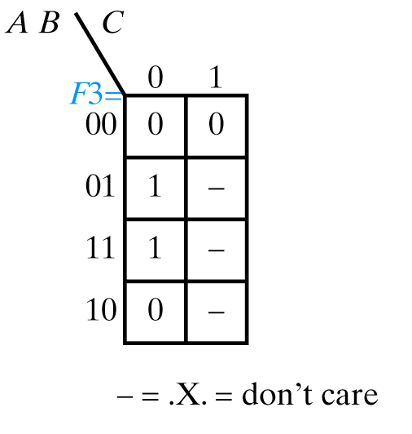
Plotting K-Maps with Xs
F3(A,B,C) = Σ(2,6) + Σmd(3,5,7)
A B C F3
0 0 0 0
0 0 1 0
0 1 0 1
0 1 1 X
1 0 0 0
1 0 1 X
1 1 0 1
1 1 1 X

Slide 36
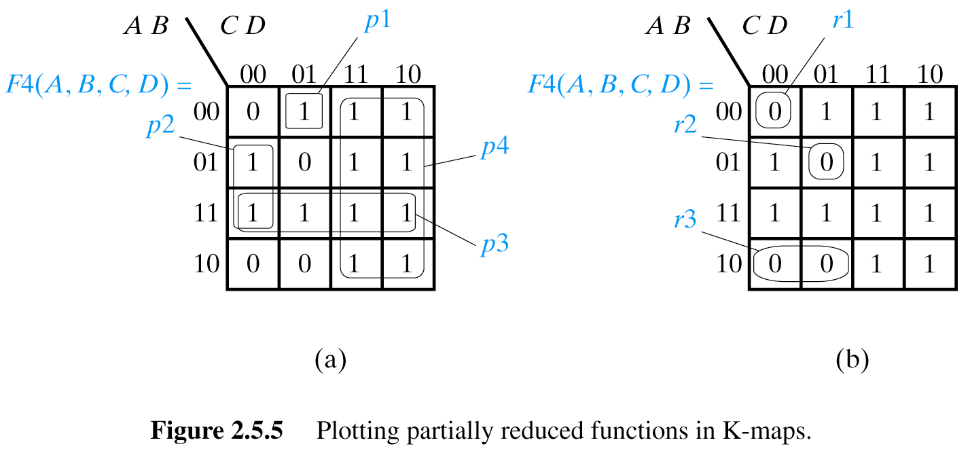
Plotting K-Maps from functions in partially reduced form
F4(A,B,C,D) = A⋅B⋅C⋅D + B⋅C⋅D + A⋅B + C
p₁
p₂
p₃
p₄
Notes:
Need to explain. Think of missing variables as input don’t cares (X) and look for row/col where fits (e.g. C = XXCX and we care only about squares where C is 1 regardless of other variables). All variables present in term: single cell; one variable missing: 1x2, two variables missing: 2x4, etc…

Slide 37
Plotting K-Maps from functions in partially reduced form
F4(A,B,C,D) = A⋅B⋅C⋅D + A⋅B⋅C⋅D + A⋅B⋅C
r₁
r₂
r₃
Notes:
Need to explain. Think of missing variables as input don’t cares (X) and look for row/col where fits (e.g. C = XXCX and we care only about squares where C is 1 regardless of other variables).

Slide 38
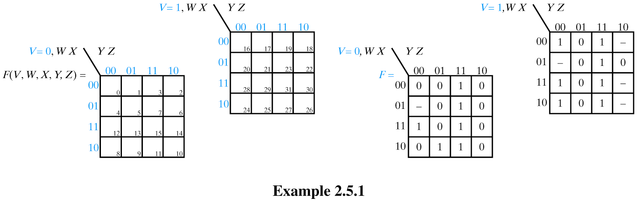
K-Maps for functions of 5 variables
F(V,W,X,Y,Z)
m₀ through m₁₅
m₁₆ through m₃₁
Notes:
Don’t usually go beyond 4 or 5 variables because there are good S/W packages to do this.
Split map into two (think of them as stacked). Still maintain Gray code.

Slide 39
K-Maps for functions of 5 variables
F(V,W,X,Y,Z) = Σ(3,7,9,11,12,15,16,19,23,24,27,28,31)
+ Σmd(4,18,20,26,30)
Notes:
Don’t usually go beyond 4 or 5 variables because there are good S/W packages to do this.
Split map into two (think of them as stacked). Still maintain Gray code.

Slide 40
Using K-Maps to Reduce Functions

Slide 41
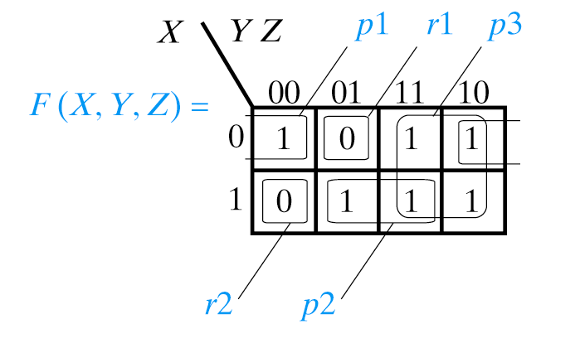
Using K-Maps to Reduce Functions
Assume you’ve plotted the K-map for F(X,Y,Z) as follows:

Slide 42
Using K-Maps to Reduce Functions
You want to obtain a reduced expression for F(X,Y,Z) in SOP form
Notes:
Smallest expressions → largest cube sizes

Slide 43
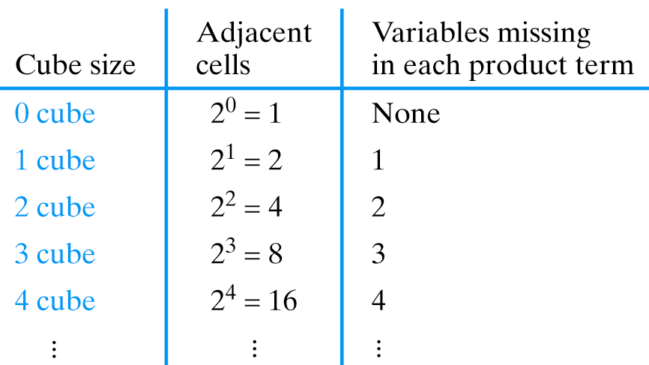
Using K-Maps to Reduce Functions
You want to obtain a reduced expression for F(X,Y,Z) in SOP form
Need to “cover” 1s
Fewest product terms
Simplest expressions
  (fewest variables)
Notes:
Smallest expressions → largest cube sizes

Slide 44
Using K-Maps to Reduce Functions
Circle all isolated 0-cubes
Circle all 1-cubes not completely contained in a larger cube
Continue for 2, 3, 4-cubes
Write the product terms (prime implicants) and OR them together
Write the expression for each product term

Slide 45
Using K-Maps to Reduce Functions
F(X,Y,Z) = p1 + p2 + p3 = X⋅Z + X⋅Z + Y
Notes:
Smallest expressions → largest cube sizes

Slide 46
Using K-Maps to Reduce Functions
F(X,Y,Z) = r1 + r2 = X⋅Y⋅Z + X⋅Y⋅Z
Notes:
Smallest expressions → largest cube sizes

Slide 47
K-Maps (Some Terminology)
Implicant: Product term of a function
Prime Implicant: Product term for a cube which is not completely contained in another cube
Essential Prime Implicant: Product term which provides the only covering for a given minterm and must always be used in the set of product term
Optional Prime Implicant: Product term which provides an alternative covering for a given minterm and may be used in the set of product terms
Redundant (Non-Essential) Prime Implicant: Product term for a cube which is completely contained in another cube (correct, but won’t lead to a minimum function)

Slide 48
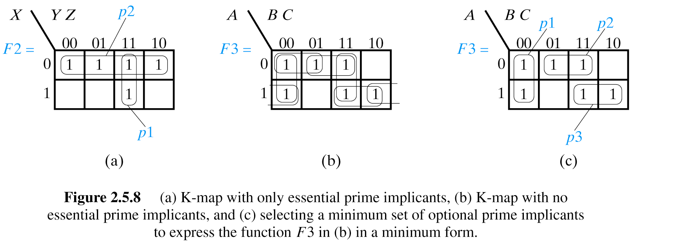
K-Map with only essential prime implicants

Slide 49
K-Map with no essential prime implicants

Slide 50
K-Map with no essential prime implicants

Slide 51
K-Map with no essential prime implicants: alternative!

Slide 52
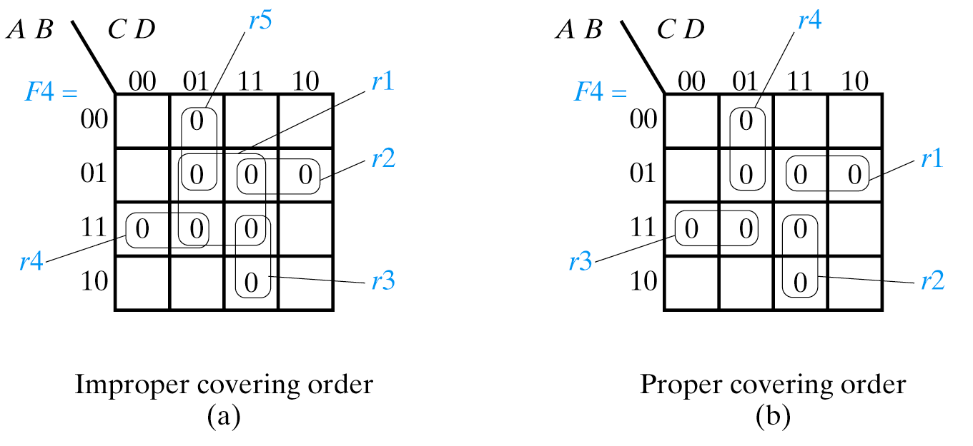
Covering Order is Essential

Slide 53
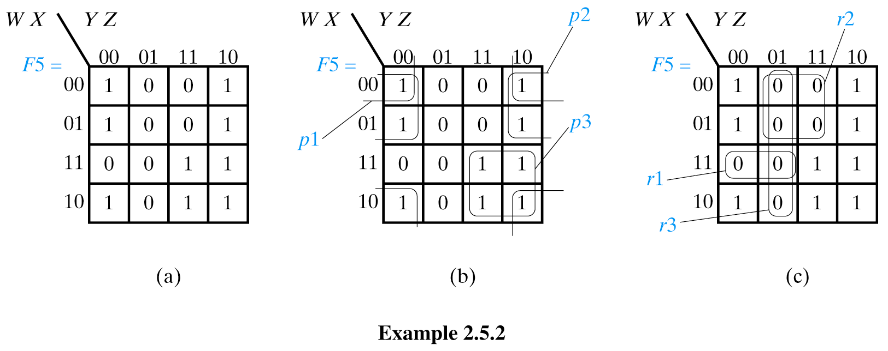
Using K-Maps to Reduce Functions
Given the following K-map, which minimum SOP form of the function
has the smallest literal count (the one for the 1s or the 0s)?
F(W,X,Y,Z) =
F(W,X,Y,Z) =
Notes:
Smallest expressions → largest cube sizes

Slide 54
Using K-Maps to Reduce Functions
lc = 6
F(W,X,Y,Z) = p1 + p2 + p3 = X⋅Z + W⋅Z + W⋅Y

Slide 55
Using K-Maps to Reduce Functions
lc = 7
F(W,X,Y,Z) = r1 + r2 + r3 = W⋅X⋅Y + W⋅Z + Y⋅Z

Slide 56
Using K-Maps to Reduce Functions
Given the following K-map, which minimum SOP form of the function
has the smallest literal count (the one for the 1s or the 0s)?
F(W,X,Y,Z) = p1 + p2 + p3 = X⋅Z + W⋅Z + W⋅Y
lc = 6
F(W,X,Y,Z) = r1 + r2 + r3 = W⋅X⋅Y + W⋅Z + Y⋅Z
lc = 7
Notes:
Smallest expressions → largest cube sizes

Slide 57
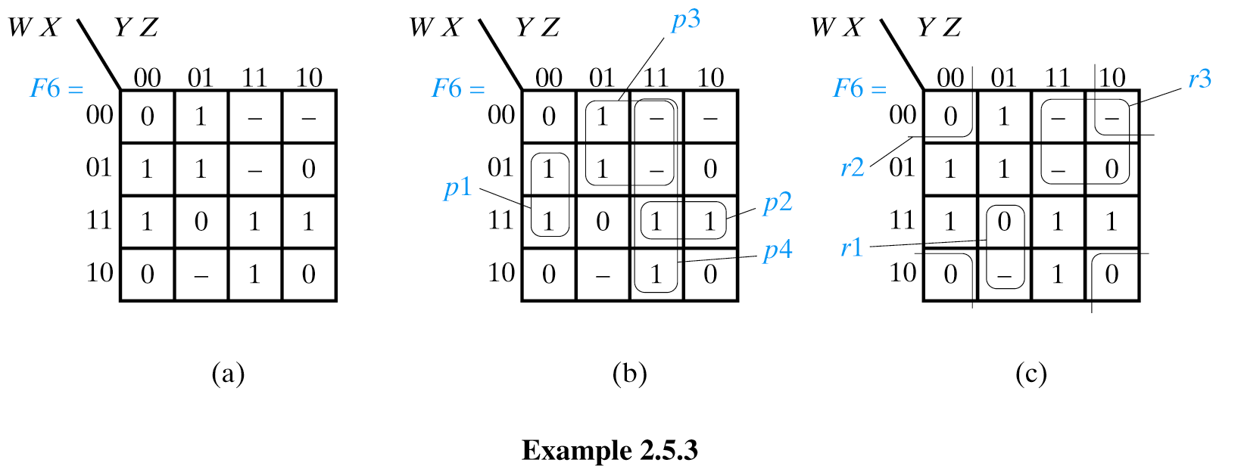
Using K-Maps to Reduce Functions
Given the following K-map, which minimum SOP form of the function
has the smallest literal count (the one for the 1s or the 0s)?
F(W,X,Y,Z) =
F(W,X,Y,Z) =
Only use don’t cares to allow larger cube sizes to be covered
Notes:
Smallest expressions → largest cube sizes

Slide 58
Using K-Maps to Reduce Functions
Only use don’t cares to allow larger cube sizes to be covered
lc = 10
F(W,X,Y,Z) = p1+p2+p3+p4 = X⋅Y⋅Z + W⋅X⋅Y + W⋅Ζ + Y⋅Z
Notes:
Smallest expressions → largest cube sizes

Slide 59
Using K-Maps to Reduce Functions
Only use don’t cares to allow larger cube sizes to be covered
lc = 7
F(W,X,Y,Z) = r1 + r2 + r3 = W⋅Y⋅Z+ X⋅Z + W⋅Y
Notes:
Smallest expressions → largest cube sizes

Slide 60
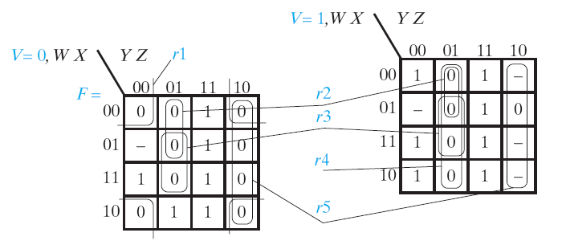
K-Maps for functions of 5 variables
F(V,W,X,Y,Z) = Σ(3,7,9,11,12,15,16,19,23,24,27,28,31)
+ Σmd(4,18,20,26,30)
Notes:
Don’t usually go beyond 4 or 5 variables because there are good S/W packages to do this.
Split map into two (think of them as stacked). Still maintain Gray code.

Slide 61
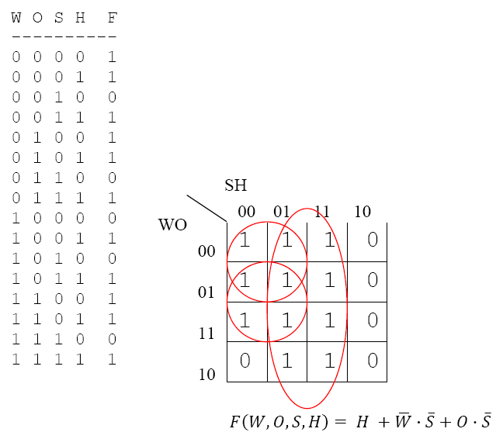
Ecotopia Revisited

Slide 62
Circuits with Multiple Outputs
Product Term Sharing
x₁
x₂
x₃
x₄
f₁
f₂

Slide 63
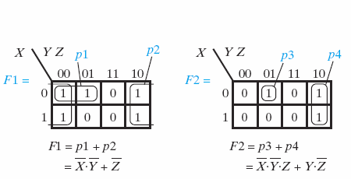
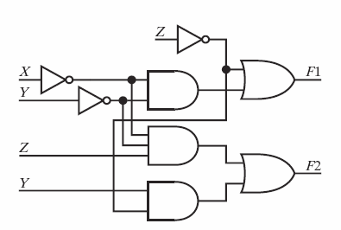
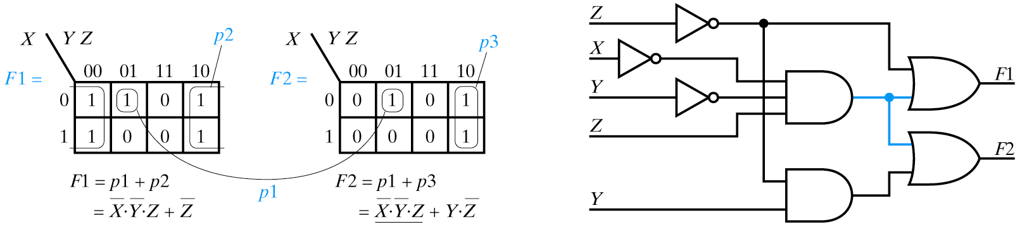
Product Term Sharing
May Result in K-Maps Different from Optimizing Separate Functions

Slide 64
K-Maps: Caveats!
Empty K-Map must be constructed correctly
  Gray Code: Adjacent cells differ in only one variable
K-Map must be plotted correctly
  Minterms from truth table or compact form
  Minterms from partially reduced expressions
K-Map must be circled correctly
  Start with smallest cubes first!
  Remember that K-Maps “wrap” at edges
Use 1s for F, 0s for F

Slide 65
Sources
Prof. Mark G. Faust
John Wakerly

